Slide 1
2025-2026
Summer Enrollment
Notes:
Hello. My name is XXXX and I am XXXX here at Collin College. Welcome to our 2024-2025 summer enrollment presentation.

Slide 2

Highlights
  Some plans will have a rate change the upcoming Fiscal Year.
  All ERS insurance carriers will remain the same.
  All insurance changes will be made on the ERS website: ers.texas.gov
  Changes to medical out-of-pocket maximums
  FSA/HSA maximums, carryover increasing

Slide 3

Summer Enrollment
  Monday, July 7th – Friday, July 18th
  Personal Benefits Enrollment Statement (PBES) will be received in the mail from ERS (mailing began 6/23).
  After changes are made, email confirmations will be sent to the email address on file with ERS.
  If you do not receive an email confirmation, your elections were not processed. Please try again.
Notes:
These changes will become effective September 1st, unless they require Evidence of Insurability which may take longer.

Slide 4
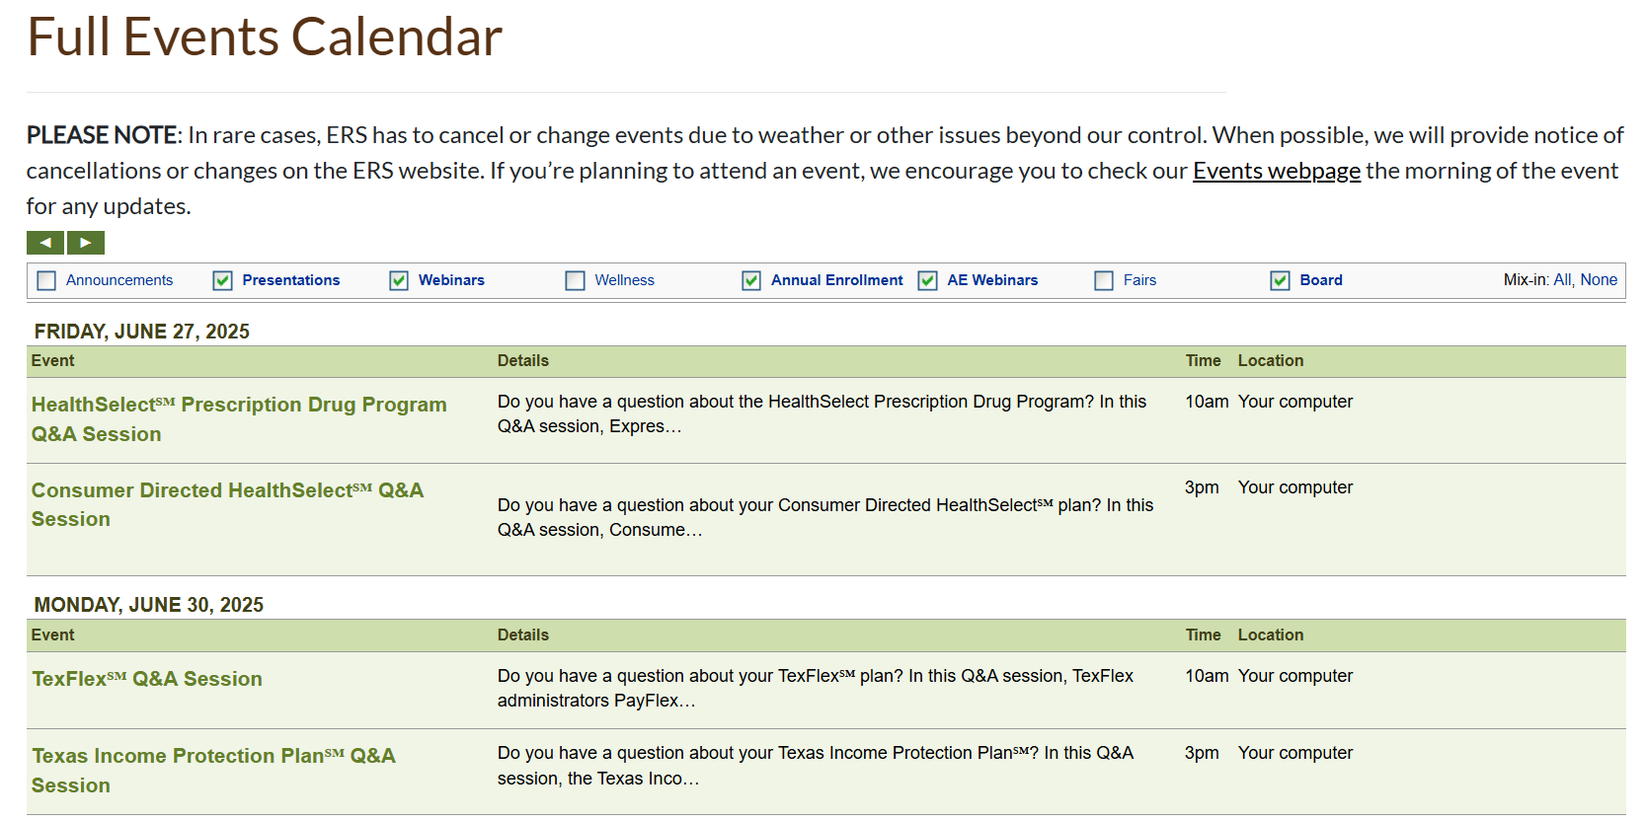
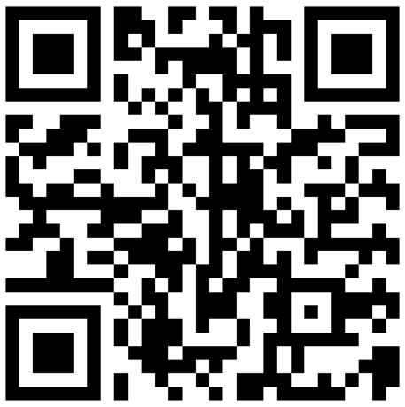
ERS Webinars www.ers.texas.gov/event-calendars
Notes:
ERS and their benefit partners are holding webinars throughout the summer enrollment season. For information on these webinars, you can visit the ERS Calendar Page to browse subjects and dates/times.

Slide 5

Eligible Dependent Verification Process
Spouse
Natural, adopted, and step-children (under 26)
Ineligible dependents may include:
  Ex-spouses
  Children over age 26
  Grandchildren or parents
Subject to a dependent verification audit by Alight Solutions. Failure to verify will cause their removal from all coverage.
Notes:
If you are adding any new dependents to your benefits for the upcoming year, you will need to submit information through the dependent verification process.

Slide 6
Tobacco User Premium
Tobacco premium charged to tobacco users – usage of any tobacco products 5+ times in the past 3 consecutive months.
  All types of tobacco: including, but not limited to cigarettes, cigars, pipe tobacco, chewing tobacco, snuff, dip and all e-cigarettes and vaping products.
If you or a covered family member use these products, you are required to report it to ERS.
Number of Tobacco-users | Monthly Premium
Employee or Spouse or Child Only | $30
Employee and Spouse or Child | $60
Employee, Spouse, and Child | $90

Slide 7


Medical Insurance and Rx Options
HealthSelect of Texas
  PCP and referrals required
  $0 Deductible
Consumer-Directed HealthSelect
  No PCP/Referrals
  $2,100/$4,200 Deductibles
Separate Rx card: Express Scripts
 | HealthSelect of Texas | Consumer Directed HealthSelect
Employee Only | $0.00 | $0.00
Employee & Child(ren) | $258. 88 | $233.00
Employee & Spouse | $386.64 | $347.96
Employee & Family | $645.52 | $580.96
Monthly premiums for full-time employees are covered at no charge to employees.

Slide 8
Out of Pocket Maximums
Effective 1/1/2026 - HealthSelect of Texas and Consumer Directed HealthSelect annual in-network out-of-pocket maximums
  $8,300 Individual (up from $8,050)
  $16,600 Family (up from $16,100)

Slide 9


Dental Insurance
No dental plan ID cards.
State of Texas Dental Choice:
PPO & Premier Networks
DeltaCare DHMO:
Must have a primary care dentist
Collin College will continue to pay for the Employee only portion of the dental premiums.
 | State of Texas Dental Choice | DeltaCare DHMO
Employee Only | $0.00 | $0.00
Employee & Child(ren) | $43.44 | $13.43
Employee & Spouse | $31.03 | $9.59
Employee & Family | $74.47 | $23.00

Slide 10

Vision Insurance
EyeMed is the third-party administrator for the State of Texas Vision.
Vision Care Services | In-Network Member Cost
Routine Eye Exam | $15 copay
Contact Lens Fitting (Standard) | $25 copay
Frames or Contact Lenses | $200 retail allowance; 20% off amount over $200
Single Vision Lenses (pair) | $10 copay
Bifocal Lenses (pair) | $15 copay
Trifocal Lenses (pair) | $20 copay
 | State of Texas Vision
Employee Only | $5.07
Employee & Child(ren) | $10.90
Employee & Spouse | $10.14
Employee & Family | $15.97

Slide 11
Life Insurance
Optional Life – Employee Coverage
Includes AD&D Provision
1 - 4 Times Annual Salary
Age-rated; Reductions Begin at age 70
Dependent Life
Includes AD&D Provision
Voluntary AD&D – Employee Only or Employee and Family
Minimum Coverage $10,000; Maximum $200,000
Basic Life $5,000
$5,000 Coverage per Covered Dependent
You must name beneficiary(ies) through your ERS Online Account. These are not maintained in Workday or by HR.
Notes:
Optional Life is both age-based and salary based.
Every five years, we jump an age bracket and 9/1 pay increases also affect this benefit. At age 70, the benefit does get reduced. Around age 60, review monthly premiums. At age 70, even more important to review monthly premiums vs benefit.

Slide 12
Texas Income Protection Plan
Short- & Long-Term Disability Insurance
Long-term disability premium is decreasing from $0.68 to $0.63 per $100 of monthly salary
Short-Term | Long-Term
66% of monthly salary (up to $10,000) | 60% of monthly salary (up to $10,000)
14-day waiting period and must exhaust all sick leave available. | 180-day waiting period and must exhaust all sick leave available.
Premiums and benefits are salary-based.

Slide 13

Flexible Spending Accounts
  Health Care FSA - Annual Max $3,300
    Use for eligible medical expenses - copays, dental expenses, glasses, contacts, prescriptions, etc.
    Carry-over up to $640 through 8/31/25, then increases to $660 for 2025-2026
  Limited-Purpose FSA - Annual Max $3,300
    For employees who enroll in Consumer Directed HealthSelect
    Use for eligible dental and vision expenses only
  Dependent Care FSA- Annual Max $5,000
    Use for eligible day care expenses for children younger than 13 or adult day care programs
Please keep your receipts or Explanation of Benefits documents (EOBs).

Slide 14

Health Savings Account
(Consumer Directed HealthSelect Enrollees Only)
  $45/month from ERS (employee only), $90/month if any dependent coverage
  2025 - $4,300 Individual; $8,550 Family
  2026 - $4,400 Individual; $8,750 Family
  Employees age 55+ can make a “catch-up” contribution of up to $1,000 annually, in addition to the annual maximum.
  Employees enrolled in Medicare cannot enroll in the HSA.
  Approximate 2-month delay in the beginning to your HSA account
Must open HSA with Optum Bank to begin receiving ERS contributions.

Slide 15


Employee Assistance Program
Full-time employees are automatically enrolled
Free, confidential short-term counseling available to full-time employees & household members
  8 visits per service type
Available 24/7: Behavioral issues, Substance abuse, Financial assistance, Legal assistance
Teen Line
Alternative Ride Reimbursement Program
Website resources include estate planning information and access to will preparation software
Notes:
The employee assistance program is another great benefit that will remain at no cost to the employee.
Please visit www.deeroakseap.com for more information regarding services through the EAP. Our username and password is collin (lower case). Feel free to take advantage of what Deer Oaks has to offer!

Slide 16


“Collin Invests” Enhanced
Retirement Savings Plan 403(b)
Transition to TIAA: go live date TBD.
403(b) – Enrollment on Corebridge website: https://www.corebridgefinancial.com/rs/home
  Employer match, up to 4% of base salary (Full-Time only)
  Must be enrolled in the 403(b) to receive the match
  3-year vesting period
  Part-Time are eligible to contribute, no employer match
457 – Enrollment on Texa$aver website: https://texasaver.empower-retirement.com
  ROTH opportunities available through Texa$aver
Notes:
This is a benefit that you are able to enroll in and make changes to at any time throughout the year. No Enrollment Period or Qualifying Life Event is necessary to make changes!

Slide 17
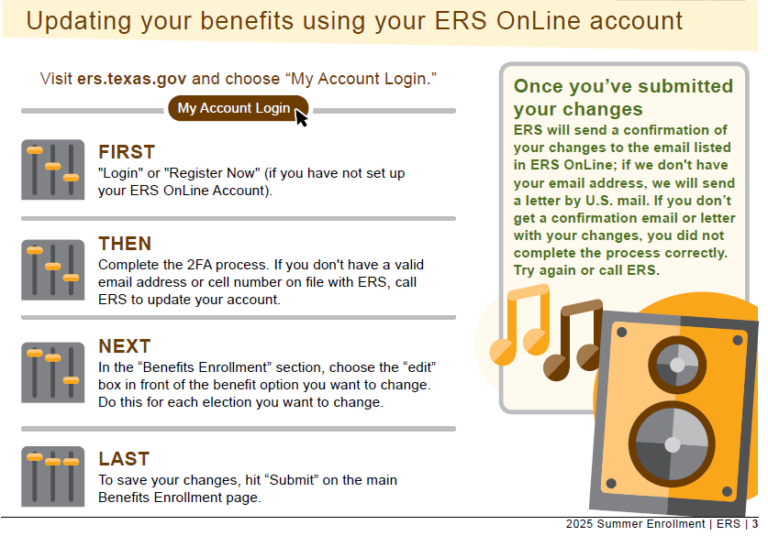

How Do I Make Changes?
Notes:
To view/update beneficiaries, you would click on “Beneficiary Summary”. To enter your OE elections, or view your current summary, you will click on “Benefits Enrollment” or “Benefits Summary”.

Slide 18



Questions?
Please contact us:
(972) 599 – 3152
benefits@collin.edu
CHEC, 3^{rd.} Floor – HR Office
Notes:
Additional information is in the email sent to you by a member of the Benefits Team. Please review all the information carefully. Should you have any questions, please do not hesitate to contact us.

